Slide 1
Unit 5 Artificial Intelligence

Slide 2
Learning Objectives
Upon completion of this unit, learners (Ls) are expected to have:
language
achieved a thorough understanding of Text A contextually and linguistically;
built up an active vocabulary around the theme of AI and its applications;
Skills
tried writing an argumentative essay for or against the use of robojudges;
tried doing a survey and giving a report on how your fellow students feel towards merging AI with humans;
Moral
learned to appreciate the changes AI is going to bring about in law and in the daily life of people, and the great potential of AI growth in China;
cultivated ability to tell Chinese stories in English and spread Chinese culture to the world.

Slide 3
CONTENTS
Part 1
Before Reading
Part 2
In Reading
Part 3
After Reading
Part 4
Critical Thinking
Part 5
Culture Focus
Part 6
Home Reading

Slide 4

Before Reading
Background information
Warm-up Questions

Slide 5

Before Reading
Watch the video clip and answer the following questions.
How did the speaker define Artificial Intelligence and Human Intelligence?
What machines have the human brain created, according to the speaker?
According to the speaker, what cannot those “inanimate objects” do? And what can they do?
What is the big question the speaker raised at the end of the clip?

Slide 6


Before Reading

Slide 7
Before Reading
Reference answers
How did the speaker define Artificial Intelligence and Human
Intelligence?
Artificial intelligence, created by man, is defined as lacking in
natural or spontaneous qualities, while human intelligence is
described as the skilled use of reason or mental acuteness.
2. What machines have the human brain created, according to the
speaker?
The computer and its codes, a chest computer, a driverless car,
surgical tools, and Alexa/Amazon Echo.

Slide 8
Before Reading
3. According to the speaker, what cannot those “inanimate objects” do? And
what can they do?
They can’t feel, but now some of them are capable of dealing with over
100 billion instructions per second, which is far more than any human
being.
4. What is the big question the speaker raised at the end of the clip?
Could these instructions ever include commands to use reason, to be
spontaneous, to feel? Could man-made become more like man?

Slide 9
Before Reading
What is Artificial Intelligence?
Artificial intelligence (AI), the ability of a digital computer or computer-controlled robot to perform tasks commonly associated with intelligent beings. The term is frequently applied to the project of developing systems endowed with the intellectual processes characteristic of humans, such as the ability to reason, discover meaning, generalize, or learn from past experience. Since the development of the digital computer in the 1940s, it has been demonstrated that computers can be programmed to carry out very complex tasks—as, for example, discovering proofs for mathematical theorems or playing chess—with great proficiency.

Slide 10
Before Reading
What is Artificial Intelligence?
Still, despite continuing advances in computer processing speed and memory capacity, there are as yet no programs that can match human flexibility over wider domains or in tasks requiring much everyday knowledge. On the other hand, some programs have attained the performance levels of human experts and professionals in performing certain specific tasks, so that artificial intelligence in this limited sense is found in applications as diverse as medical diagnosis, computer search engines, and voice or handwriting recognition.

Slide 11
Before Reading
What is Artificial Intelligence?
There are numerous, real-world applications of AI systems today. Below are some of the most common examples:
Speech recognition: It is also known as automatic speech recognition (ASR), computer speech recognition, or speech-to-text, and it is a capability which uses natural language processing (NLP) to process human speech into a written format. Many mobile devices incorporate speech recognition into their systems to conduct voice search—e.g. Siri—or provide more accessibility around texting.

Slide 12
Before Reading
What is Artificial Intelligence?
Customer service: Online virtual agents are replacing human agents along the customer journey. They answer frequently asked questions (FAQs) around topics, like shipping, or provide personalized advice, cross-selling products or suggesting sizes for users, changing the way we think about customer engagement across websites and social media platforms. Examples include messaging bots on e-commerce sites with virtual agents, messaging apps, such as Slack and Facebook Messenger, and tasks usually done by virtual assistants and voice assistants.

Slide 13
Before Reading
What is Artificial Intelligence?
Computer vision: This AI technology enables computers and systems to derive meaningful information from digital images, videos and other visual inputs, and based on those inputs, it can take action. This ability to provide recommendations distinguishes it from image recognition tasks. Powered by convolutional neural networks, computer vision has applications within photo tagging in social media, radiology imaging in healthcare, and self-driving cars within the automotive industry.

Slide 14
Before Reading
What is Artificial Intelligence?
Recommendation engines: Using past consumption behavior data, AI algorithms can help to discover data trends that can be used to develop more effective cross-selling strategies. This is used to make relevant add-on recommendations to customers during the checkout process for online retailers.
Automated stock trading: Designed to optimize stock portfolios, AI-driven high-frequency trading platforms make thousands or even millions of trades per day without human intervention.

Slide 15
Before Reading
Warm-up Questions
1. How much do you know about AI? What AI applications can
you think of?
2. How fast is China’s AI technology developing? What are the
present achievements?
3. Do you think AI robots would replace humans? Why or why
not?

Slide 16
In Reading
Global Reading
Detailed Reading

Slide 17
In Reading – Global Reading
Text Analysis
Read Paras. 2–6 to find the author’s views on the use of robojudges.
Paragraph No. | Topic of Discussion | Author’s View
2 | Legal Standards
3 | The Beckwith Case
Robojudges can tirelessly apply the same high legal standards to every judgment without succumbing to human weaknesses.
In contrast with humans, Robojudges are free from the various social and gender biases and could in principle ensure equal justice under the law.

Slide 18
In Reading – Global Reading
Paragraph No. | Topic of Discussion | Author’s View
4 | Accidental Human Biases
5 | Efficiency and Fairness
6 | Bugs and Hacks
In contrast with humans, robojudges are not affected by factors such as hunger and fatigue. They have unlimited memory and capacity.
Efficiency makes robojudges fairer still.
A very real problem, especially when the stakes are high. Besides, people may not respect a robojudge’s judgment.

Slide 19
In Reading – Global Reading
Read Paras. 8–12 to find the author’s attitude towards changing the law to keep pace with AI development.
Paragraph No. | Topic of Discussion | Author’s View
8 | Privacy or Freedom of Information
9 | AI Regulation
The trend is toward reduced privacy.
The government should provide insight instead of oversight.

Slide 20
In Reading – Global Reading
Paragraph No. | Topic of Discussion | Author’s View
10 | Granting Rights to Machines
11 | Granting Property Rights to Machines
12 | Granting Voting Rights to Machines
Allowing self-driving cars to hold insurance might be a good idea.
Granting property rights to non-human entities is the trend.
The question is open to debate.

Slide 21
In Reading – Detailed Reading
Law in the Age of Artificial Intelligence
Max Tegmark
We humans are social animals who subdued all other species and conquered Earth thanks to our ability to cooperate. We’ve developed laws to incentivize and facilitate cooperation, so if AI can improve our legal and governance systems, then it can enable us to cooperate more successfully than ever before, bringing out the very best in us. And there’s plenty of opportunity for improvement here, both in how our laws are applied and how they’re written.

Slide 22
In Reading – Detailed Reading
What are the first associations that come to your mind when you think about the court system in your country? If it’s lengthy delays, high costs and occasional injustice, then you’re not alone. Wouldn’t it be wonderful if your first thoughts were instead “efficiency” and “fairness”? Since the legal process can be abstractly viewed as a computation, inputting information about evidence and laws and outputting a decision, some scholars dream of fully automating it with robojudges: AI systems that tirelessly apply the same high legal standards to every judgment without succumbing to human weaknesses such as bias, fatigue or lack of the latest knowledge.

Slide 23
In Reading – Detailed Reading
Byron De La Beckwith Jr. was convicted in 1994 of assassinating civil rights leader Medgar Evers in 1963, but two separate all-white Mississippi juries had failed to convict him the year after the murder, even though the physical evidence was essentially the same. Alas, legal history is rife with judgments biased by skin color, gender, sexual orientation, religion, nationality and other factors. Robojudges could in principle ensure that, for the first time in history, everyone becomes truly equal under the law: they could be programmed to all be identical and to treat everyone equally, transparently applying the law in a truly unbiased fashion.

Slide 24
In Reading – Detailed Reading
Robojudges could also eliminate human biases that are accidental rather than intentional. For example, a controversial 2012 study of Israeli judges claimed that they delivered significantly harsher verdicts when they were hungry: whereas they denied about 35% of parole cases right after breakfast, they denied over 85% right before lunch. Another shortcoming of human judges is that they may lack sufficient time to explore all details of a case. In contrast, robojudges can easily be copied, since they consist of little more than software, allowing all pending cases to be processed in parallel rather than in series, each case getting its own robojudge for as long as it takes. Finally, while it’s impossible for human judges to master all technological knowledge required for every possible

Slide 25
In Reading – Detailed Reading
case, from thorny patent disputes to murder mysteries hinging on the latest forensic science, future robojudges may have essentially unlimited memory and learning capacity.
One day, such robojudges may therefore be both more efficient and fairer, by virtue of being unbiased, competent and transparent. Their efficiency makes them fairer still: by speeding up the legal progress and making it harder for savvy lawyers to skew the outcome, they could make it dramatically cheaper to get justice through the courts. This could greatly increase the chances of a cash-strapped individual or startup company prevailing against a billionaire or multinational corporation with an army of lawyers.

Slide 26
In Reading – Detailed Reading
On the other hand, what if robojudges have bugs or get hacked? Both have already afflicted automatic voting machines, and when years behind bars or millions in the bank are at stake, the incentives for cyberattack are greater still. Even if AI can be made robust enough for us to trust that a robojudge is using the legislated algorithm, will everybody feel that they understand its logical reasoning enough to respect its judgment?
So far, we’ve explored only the application of law; let us now turn to its content. There’s broad consensus that our laws need to evolve to keep pace with our technology. For example, the two programmers who created the

Slide 27
In Reading – Detailed Reading
ILOVEYOU worm and caused billions of dollars in damages were acquitted of all charges and walked free because at that time, there were no laws against malware creations in the Philippines. Since the pace of technological progress appears to be accelerating, laws need to be updated even more rapidly. Getting more tech-savvy people into law schools and governments is probably a smart move for society. But should AI-based decision support systems for voters and legislators ensue, followed by outright robo-legislators?

Slide 28
In Reading – Detailed Reading
How to best alter our laws to reflect AI progress is a fascinating controversial topic. One dispute reflects the tension between privacy and freedom of information. Freedom fans argue that the less privacy we have, the more evidence the courts will have, and the fairer the judgments will be. For example, if the government taps into everyone’s electronic devices to record where they are and what they type, click, say and do, many crimes would be readily solved, and additional ones could be prevented. Moreover, machine-learning techniques have gotten better at analyzing brain data from fMRI scanners to determine what a person is thinking about and, in particular, whether they’re telling the truth or lying. If AI-assisted brain scanning

Slide 29
In Reading – Detailed Reading
technology became commonplace in the courtroom, the currently tedious process of establishing the facts of a case could be dramatically simplified and expedited, enabling faster trials and fairer judgments. But privacy advocates might worry about whether such systems occasionally make mistakes and, more fundamentally, whether our minds should be off-limits to government snooping. Governments that don’t support freedom of thought could use such technology to criminalize the holding of certain beliefs and opinions. Where would you draw the line between protecting society and protecting personal freedom? Wherever you draw it, will it gradually but inexorably move

Slide 30
In Reading – Detailed Reading
toward reduced privacy to compensate for the fact that evidence gets easier to fake? For example, once AI becomes able to generate fully realistic fake videos of you committing crimes, will you vote for a system where the government tracks everyone’s whereabouts at all times and can provide you with an ironclad alibi if needed?
Another captivating controversy is whether AI research should be regulated or more generally, what incentives policymakers should give AI researchers to maximize the chances of a beneficial outcome. Some AI researchers have argued against all forms of regulation of AI development, claiming that they would needlessly delay urgently needed

Slide 31
In Reading – Detailed Reading
innovation (for example, lifesaving self- driving cars) and would drive cutting-edge AI research underground and/or to other countries with more permissive governments. At the Puerto Rico Beneficial AI conference, Elon Musk argued that what we need right now from governments isn’t oversight but insight: specifically, technically capable people in government positions who can monitor AI’s progress and steer it if warranted down the road. He also argued that government regulation can sometimes nurture rather than stifle progress: for example, if government safety standards for self-driving cars can help reduce the number of self-driving car accidents, then a public backlash is less likely

Slide 32
In Reading – Detailed Reading
and adoption of the new technology can be accelerated. The most safety-conscious AI companies might therefore favor regulation that forces less scrupulous competitors to match their high safety standards.
Yet another interesting legal controversy involves granting rights to machines. If self-driving cars cut the 32,000 annual U.S. traffic fatalities in half, perhaps carmakers won’t get 16,000 thank-you notes, but 16,000 lawsuits. So if a self-driving car causes an accident, who should be liable — its occupants, its owner or its manufacturer? Legal scholar David Vladeck has proposed a fourth answer: the car itself! Specifically,

Slide 33
In Reading – Detailed Reading
he proposes that self-driving cars be allowed (and required) to hold car insurance. This way, models with a sterling safety record will qualify for premiums that are very low, probably lower than what’s available to human drivers, while poorly designed models from sloppy manufacturers will only qualify for insurance policies that make them prohibitively expensive to own.
But if machines such as cars are allowed to hold insurance policies, should they also be able to own money and property? If so, there’s nothing legally stopping smart computers from making money on the stock market and using it to buy online services. Once a computer starts paying humans to work for

Slide 34
In Reading – Detailed Reading
it, it can accomplish anything that humans can do. If AI systems eventually get better than humans at investing (which they already are in some domains), this could lead to a situation where most of our economy is owned and controlled by machines. Is this what we want? If it sounds far-off, consider that most of our economy is already owned by another form of nonhuman entity: corporations, which are often more powerful than any one person in them and can to some extent take on a life of their own.

Slide 35
In Reading – Detailed Reading
If you’re OK with granting machines the rights to own money and property, then how about getting them the right to vote? If so, should each computer program get one vote, even though it can trivially make trillions of copies of itself in the cloud if it’s rich enough, thereby guaranteeing that it will decide all elections? If not, then on what moral basis are we discriminating against machine minds relative to human minds?

Slide 36
In Reading – Detailed Reading
Question 1: The author says at the beginning of the essay that we humans are social animals who subdued all other species and conquered Earth thanks to our ability to cooperate. Do you agree with him?
Have we really subdued all other species and conquered Earth? I very much doubt it. Many of the harmful insects still remain in spite of our use of insecticides, to say nothing of the germs and viruses that have caused so many deaths among us. In fact some of the insects have evolved to be stronger and more destructive.

Slide 37
In Reading – Detailed Reading
Question 2: Do you foresee any danger of AI growing out of control?
I think the danger cannot be underestimated. If robots are programmed to have the capacity to redesign and upgrade themselves, the likelihood of them becoming destructive is real, and they may someday prevail over humans. That’s why Stephen Hawking said that AI may be the worst thing that can happen to humanity.

Slide 38
In Reading – Detailed Reading
由于法律程序可以抽象地看做一种计算，输入有关证据和法律的信息，输出一个裁决，一些学者就梦想用机器人法官来实现完全自动化。(Para. 2)
Since the legal process can be abstractly viewed as a computation, inputting information about evidence and laws and outputting a decision, some scholars dream of fully automating it with robojudges.

Slide 39
In Reading – Detailed Reading
因此，总有一天，这种机器人法官由于没有偏见，非常称职，且透明办案，从而可能做到不但效率更高而 且更加公正。(Para. 5)
One day, such robojudges may therefore be both more efficient and fairer, by virtue of being unbiased, competent and transparent.

Slide 40
In Reading – Detailed Reading
人们普遍一致认为我们的法律需要不断发展，以跟上技术发展的步伐。(Para. 7)
There’s broad consensus that our laws need to evolve to keep pace with our technology.

Slide 41
In Reading – Detailed Reading
因此，最注重安全的人工智能公司可能会喜欢监管，迫使那些不如自己谨慎的竞争对手也采用同样高的 安全标准。(Para. 9)
The most safety-conscious AI companies might therefore favor regulation that forces less scrupulous competitors to match their high safety standards.

Slide 42
In Reading – Detailed Reading
这样的话，有着良好安全记录的车型将有资格获得非常低的保费，可能低于自然人驾驶者所需的保费，而粗制滥造、设计拙劣的车型保费门槛很高，使人对这些车型望而却步。(Para. 10)
This way, models with a sterling safety record will qualify for premiums that are very low, probably lower than what’s available to human drivers, while poorly designed models from sloppy manufacturers will only qualify for insurance policies that make them prohibitively expensive to own.

Slide 43
In Reading – Language Focus
facilitate: vt. make easier; help bring about 使容易，使便利；促进
e.g. Cultural exchanges between countries facilitate mutual
understanding.
国与国之间的文化交流促进相互理解。
Computers can be used to facilitate language learning.
使用计算机可以使语言学习更方便。

Slide 44
In Reading – Language Focus
bring out: nurture and develop 培育
e.g. A crisis can bring out the best and the worst in people.
You need to add a little more salt to
要稍许多加点盐，才能使肉味更鲜。
危机可以调动人的最佳潜质，也可暴露人的最劣品性。
bring out the flavor of the meat.

Slide 45
In Reading – Language Focus
bias: 1) n. an irrational preference 偏见，偏心
e.g. The writer claims that, social or political.
作者声称他毫无偏见，没有社会偏见也没有政治偏见。
2) vt. cause to feel or show prejudice 使存偏见
e.g. The candidate claimed that the media were biased against him.
he is free from bias，
这位竞选人声称媒体对他不公。

Slide 46
In Reading – Language Focus
orientation: n. one’s basic attitudes or beliefs; training for a new job or activity 倾
向，取向；职前培训
e.g. The company employs people without regard to their political or
religious orientation.
这些材料是供新职员培训使用的。
公司聘用人员不考虑他们的政治或宗教倾向。
These materials are for the orientation of new employees.

Slide 47
In Reading – Language Focus
identical: a. being the same 完全相同的
e.g. The sisters were almost identical in appearance.
姐妹俩长得几乎一模一样。
The results were identical to those of the first test.
结果与第一次检测完全一致。

Slide 48
In Reading – Language Focus
fashion: n. manner, way; the latest or most admired style in clothes, behavior, etc.
方 式；时尚
e.g. Jim guided the visitors out of the building .
吉姆领着来访者有序地走出大楼。
Mary is a vain girl. She always wears the latest fashion.
in an orderly fashion
玛丽爱虚荣，她总是穿最时髦的衣裳。

Slide 49
In Reading – Language Focus
controversial: a. causing a lot of disagreement 有争议的
e.g. Her speech steered clear of controversial issues.
她的讲话避开了有争议的问题。
这位获得诺贝尔奖的作家在他本国颇受争议。
The Nobel Prize winning writer is quite controversial in his own country.

Slide 50
In Reading – Language Focus
pending: 1) a. not yet decided 悬而未决的
e.g. The lawsuit is still pending in the trial court.
案子还在初审法院悬着呢。
2) prep. during; while awaiting 在…期间；在等待…之际
e.g. Diagnosis was deferred pending further assessment.
诊断结论还有待进一步评估才能出来。
Pending his return let’s get everything ready.
在他回来之前，我们把一切准备好。

Slide 51
In Reading – Language Focus
prevail: vi. defeat 打败，战胜
e.g. We are confident that justice will prevail in the end.
我们深信正义最终会胜利。
Logic finally prevailed over emotion in the debate.
在这次辩论中，逻辑最终战胜了情绪。

Slide 52
In Reading – Language Focus
at stake: to be won or lost; at risk 得失攸关
e.g.
Thousands of lives will be at stake if emergency aid does not
arrive in the city soon.
如果紧急救援不能很快进城，数千人的生命将危在旦夕。

Slide 53
In Reading – Language Focus
incentive: n. a thing that motivates or encourages one to do sth. 刺激；
诱因；动机
e.g. As an added incentive, there’s a bottle of champagne for the
winning team.
Farmers lack any incentive to manage their land organically.
农场主们缺乏对土地进行有机管理的动机。
获胜团队还将获得一瓶香槟酒，这算是额外激励。

Slide 54
In Reading – Language Focus
keep pace with: go or make progress at the same speed as (sb./sth.) 跟上，
与…同步
e.g. Pensions and benefits had not risen to keep pace with the rate of
inflation, especially in recent years.
养老金和福利待遇没有跟上通胀的步伐，尤其是在近几年。
The company is struggling to keep pace with changes in the market.
公司正在努力争取跟上市场的变化。

Slide 55
In Reading – Language Focus
update: vt. bring up to date 更新
e.g. Apple updated its operating system for the iPhone and iPad earlier
this year.
今年年初，苹果公司更新了它生产的手机和平板电脑的操作
系统。
Can you update me on what’s been happening?
你能说说近来都发生了什么事，让我跟上形势吗？

Slide 56
In Reading – Language Focus
tap into: gain access to some resource; take advantage of 挖掘；开发，
利用
e.g. Our competitors tried to tap into our regional networks for customer
information.
我们的竞争对手曾企图入侵我们的区域网站获取客户信息。
If you get lost in the woods, you can tap into GPS and get an instant
position on the digitized map.
如果在林子里迷了路，你可以利用GPS找到自己在数字化地图上的
实时位置。

Slide 57
In Reading – Language Focus
advocate: n. one who publicly supports a particular cause or policy 提倡
者；拥护者
e.g. She’s a passionate advocate of free medical care for all.
她极力提倡全民免费医疗。
Gun control advocates in America are lobbying hard for new laws.
美国主张控制枪支的人正在为新的法律积极游说。

Slide 58
In Reading – Language Focus
draw the line (between): clearly separate or create a boundary for two things
划分
e.g. Where do we draw the line between those who are poor and those who are not?
我们怎么划分谁穷谁富呢？
In attempting to draw the line between normal and abnormal behavior, we
must put the individual in his particular social context.
要区分正常与不正常行为的界限，我们要把个人放在他所处的特定社会
环境里衡量。

Slide 59
In Reading – Language Focus
generate: vt. produce 生成，产生
e.g. The candidate made a speaking tour across the country to generate
public support for his policy.
竞选者在全国巡回演说，以赢得公众对他的政策的支持。
Such a profitable business is sure to generate interest among potential
investors.
这么赚钱的企业肯定会引发潜在投资者的兴趣。

Slide 60
In Reading – Language Focus
regulate: vt. make regulations for 为…制定规章，规范；控制，管理
e.g. The United States Congress has the power to regulate inter-state
commerce.
美国国会有权调控州际商务。
Sweating is a way to help us regulate body temperature.
出汗是帮助调节体温的一种方法。

Slide 61
In Reading – Language Focus
beneficial: a. favorable or advantageous 有益的
e.g. They finally came to a mutually beneficial agreement.
他们最终达成了互惠协议。
He hopes the new drug will prove beneficial to many older people.
他希望这款新药会对许多老年人有益。

Slide 62
In Reading – Language Focus
oversight: n. supervision 监管
e.g. The new manager was given oversight of the project.
新经理被授权监管该项目。
Because these programs are typically based overseas,
maintaining oversight and monitoring effectiveness can be difficult.
由于这些项目通常都在海外，维持监管和监测效果都可能有难度。

Slide 63
In Reading – Language Focus
monitor: vt. keep close watch over 密切监视；监督
e.g. Her heartbeat and blood pressure are being closely monitored.
正密切监视着她的心跳和血压。
The police use electronic tags to monitor the whereabouts of young
offenders on parole.
警察用电子追踪器来监视被保释的轻罪年轻人的行踪。

Slide 64
In Reading – Language Focus
steer: vt. control the course of; follow or move in a set course 指引…的路线；
行进
e.g. Helen tried to steer the conversation away from herself.
海伦试图把话题从自己身上引开。
Teachers should try to steer pupils away from drugs.
教师应努力引导学生远离毒品。
The ship steered towards the southern tip of the island.
船向岛的南端驶去。

Slide 65
In Reading – Language Focus
stifle: vt. deter, discourage 抑止；遏制
e.g. She managed to stifle a yawn.
她忍住了没打呵欠。
With his future career at stake, the incentive for him to stifle
opposition during the campaign was great.
事关他的前程，驱使他在竞选期间打压反对派的动力是很强的。

Slide 66
In Reading – Language Focus
liable: a. legally obligated; responsible 有（法律）责任的
e.g. The law holds parents liable if a child does not attend school.
如果孩子不上学，家长要承担法律责任。
Failure to pay taxes will make one liable to prosecution.
不交税要被追究刑事责任

Slide 67
In Reading – Language Focus
qualify: v. (cause to) meet the required standard（使）合格
e.g. An employee will automatically qualify for a pension.
只要被聘用，就有资格享受养老金。
The win qualifies her to compete in the final race.
这次获胜使她有资格进入赛跑决赛。

Slide 68
In Reading – Language Focus
take on: acquire as, or as if, one’s own 获得
e.g. The problem was beginning to take on gigantic proportions.
问题变大了。
The plaza took on a festive air as New Year approached.
随着新年临近，广场呈现一派节日气氛。

Slide 69
In Reading – Language Focus
discriminate: vi. make a difference in treatment on a basis other than
individual merit 歧视
e.g. A teacher should not discriminate against underachievers.
教师不应歧视成绩差的学生。
Two old fire-fighters who lost their jobs claimed that they were
discriminated against on account of age.
两名丢了饭碗的老消防队员声称他们受到年龄歧视。

Slide 70
After Reading
Sentence Translation
Sentence Structure
Writing Task
Speaking Task

Slide 71
After Reading-Sentence Translation
Sentence Translation
Translate the following sentences into English.
1)由于法律程序可以抽象地看做一种计算，输入有关证据和法律的信息，输出一个裁决，一些学者就梦想 用机器人法官来实现完全自动化。(Para. 2)
Since the legal process can be abstractly viewed as a computation, inputting information about evidence and laws and outputting a decision, some scholars dream of fully automating it with robojudges.

Slide 72
After Reading-Sentence Translation
2) 因此，总有一天，这种机器人法官由于没有偏见，非常称职，且透明办案，从而可能做到不但效率更高而 且更加公正。(Para. 5)
One day, such robojudges may therefore be both more efficient and fairer, by virtue of being unbiased, competent and transparent.

Slide 73
After Reading-Sentence Translation
3) 人们普遍一致认为我们的法律需要不断发展，以跟上技术发展的步伐。(Para. 7)
There’s broad consensus that our laws need to evolve to keep pace with our technology.

Slide 74
After Reading-Sentence Translation
4) 因此，最注重安全的人工智能公司可能会喜欢监管，迫使那些不如自己谨慎的竞争对手也采用同样高的安全标准。(Para. 9)
The most safety-conscious AI companies might therefore favor regulation that forces less scrupulous competitors to match their high safety standards.

Slide 75
After Reading-Sentence Translation
5) 这样的话，有着良好安全记录的车型将有资格获得非常低的保费，可能低于自然人驾驶者所需的保费，而粗制滥造、设计拙劣的车型保费门槛很高，使人对这些车型望而却步。(Para. 10)
This way, models with a sterling safety record will qualify for premiums that are very low, probably lower than what’s available to human drivers, while poorly designed models from sloppy manufacturers will only qualify for insurance policies that make them prohibitively expensive to own.

Slide 76
After Reading-Sentence Structure
Sentence Structure
noun/pronoun + gerund
Study the structure and meaning of the following sentence:
This could greatly increase the chances of a cash-strapped individual or startup
company prevailing against a billionaire or multinational corporation with an
army of lawyers. (Text A)
Now compare the following sentences and tell their difference in meaning:
Mom insisted on tidying my room for me.
Mom insisted on me/my tidying my room.

Slide 77
After Reading-Sentence Structure
Translate the following sentences using the “noun/pronoun + gerund” structure:
我讨厌他把我称作孩子。
I hate him calling me a kid.
2) 我弟弟不喜欢人们告诉他该做什么。
My younger brother doesn’t like people telling him what to do.

Slide 78
After Reading-Sentence Structure
3) 我的室友不停地抱怨他运气不好，我都听腻了。
I am tired of listening to my roommate constantly complaining about his misfortunes.
4) 我认为詹妮在辩论决赛中获胜的可能性还是很大的。
I think the chances of Jenny winning in the final debate are great.
5) 我要早一点离开派对，你介意吗？
Would you mind me/my leaving the party early?
6) 机器人拥有财产的前景看来并不很遥远。
The prospect of robots owning property doesn’t look very remote.

Slide 79
After Reading- Writing Task
Writing Strategy
Cohesion (II)
In Unit 3 we discussed the various cohesive devices in essay writing. One of them is repetition. However, repetition for the purpose of cohesion does not mean using the same word again and again. See the following paragraph taken from Paragraph 2, Text B, Unit 4, Book IV. Pay close attention to the italicized parts:

Slide 80
After Reading- Writing Task
1）During the past quarter century this power has not only increased to
one of disturbing magnitude but it has changed in character. 2）The most
alarming of all man’s assaults upon the environment is the contamination of
air, earth, rivers, and sea with dangerous and even lethal materials. 3）This
pollution is for the most part irrecoverable; 4）the chain of evil it initiates
not only in the world that must support life but in living tissues is for the
most part irreversible …
In the above sequence of sentences, “this power” (man’s power to alter the nature of his world) in sentence 1 is substituted by “man’s assaults” in sentence 2, “contamination” in sentence 2 becomes “pollution” in sentence 3, and “irrecoverable” in sentence 3 is replaced by “irreversible” in sentence 4.

Slide 81
After Reading- Writing Task
As we can see, by using different words to refer to the same thing, the author makes her writing more interesting to read and easier to understand.
Now, read the following paragraph to find the cohesive devices used therein：
Robojudges could also eliminate human biases that are accidental rather than intentional. For example, a controversial 2012 study of Israeli judges claimed that they delivered significantly harsher verdicts when they were hungry: whereas they denied about 35% of parole cases right after breakfast, they denied over 85% right before lunch. Another shortcoming of human judges is

Slide 82
After Reading- Writing Task
that they may lack sufficient time to explore all details of a case. In contrast, robojudges can easily be copied, since they consist of little more than software, allowing all pending cases to be processed in parallel rather than in series, each case getting its own robojudge for as long as it takes. Finally, while it’s impossible for human judges to master all technological knowledge required for every possible case, from thorny patent disputes to murder mysteries hinging on the latest forensic science, future robojudges may have essentially unlimited memory and learning capacity. (Para. 4, Text A, Unit 5, Book IV）

Slide 83
After Reading- Writing Task
Tips for presenting your arguments cohesively
Go over the requirements for an argumentative essay set forth in Unit 2, and make sure that you meet these requirements in your writing.
Make sure that sentences are well connected in your writing, by using the various cohesive devices such as transitional expressions, repetition, etc.
Try to diversify your choice of words and avoid simple repetition.

Slide 84
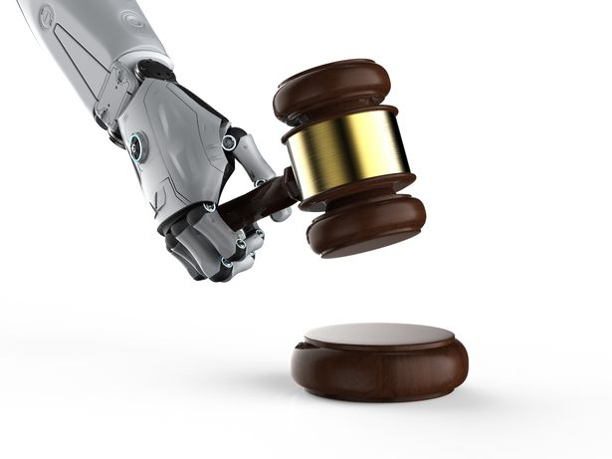
After Reading- Writing Practice
Writing Practice
Please write an essay arguing for or against the use of robojudges.

Slide 85
After Reading- Speaking Task
Speaking Task
Directions: Suppose you work for the campus radio/TV station. After hearing about cyborgs in the Viewing & Comprehension Practice, you wonder how your fellow students feel towards merging AI with humans. Therefore you decide to produce a report for your radio/TV station by doing a survey.
You may follow the steps below:
Step 1 Divide into groups of 4-6 students.

Slide 86
After Reading- Speaking Task
Step 2 Design a survey on merging AI with humans (questions could relate to the
willingness to try implants, the expected functions of such implants, the risks
involved, the safety measures to be taken, etc.). Remember to include both
objective questions and subjective questions. There are free online survey
tools and mobile apps for you to take advantage of.
Step 3 Conduct the survey among at least 20 students.
Step 4 Run an analysis of the survey results and prepare a summary. If you use an
online tool or mobile app, such analyses could be automated.
Step 5 Report your major findings in class

Slide 87
Critical Thinking
Choose one of the following questions, and discuss with your group members. You are supposed to state your opinions clearly and then explain them with statistics, details and examples.
In what areas is China already ahead of other countries in the application of AI?
Do you think we Chinese may have a good chance at getting ahead with AI-related legislations? Why?

Slide 88
Critical Thinking
Choose one of the following questions, and discuss with your group members. You are supposed to state your opinions clearly and then explain them with statistics, details and examples.
In what areas is China already ahead of other countries in the application of AI?
Do you think we Chinese may have a good chance at getting ahead with AI-related legislations? Why?

Slide 89
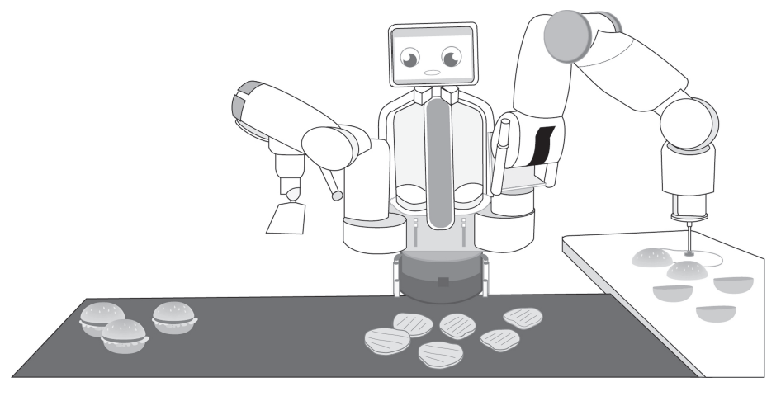
Critical Thinking
Describe the picture, and use your imagination to predict what changes might happen in the service industry in the near future with the rapid development of artificial intelligence.

Slide 90
Culture Focus-The Four Great Inventions: new version
The new version of China's “Four Great Inventions”
The “Four Great Inventions” of ancient China are widely known to be the compass, gunpowder, papermaking and printing, which had once significantly boosted the world’s progress of civilization.
In recent years, the country has been gaining momentum in developing and creating science and technology, and from this, several new inventions have emerged, attracting global attention again.

Slide 91
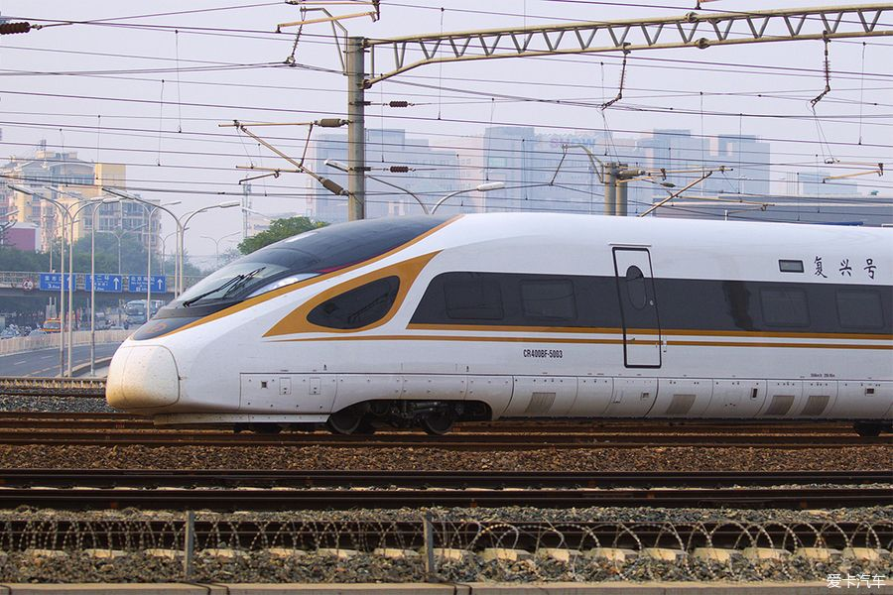
Culture Focus-The Four Great Inventions: new version
China, which boasts epochal inventions in ancient times, has once again demonstrated its ability to change the world with its "new four great inventions": high-speed railways, electronic payments, shared bicycles and online shopping.
High-speed railway: New calling card
The Chinese high-speed railway, which has become a new calling card for China in recent years, was on top of the list. Though originally invented by the Japanese, China’s rapidly expanding high-speed railway networks have recently impressed the world.

Slide 92
Culture Focus-The Four Great Inventions: new version
By the end of 2016, China’s high-speed railway has exceeded 22,000 kilometers, accounting for 60 percent of the world’s overall high-speed railway.
On September 25, 2017, just ahead of the National Day holiday, China launched its self-developed bullet train: “Fuxing”, which boasts a top speed of 400 km/h. The trains’ arrival has shortened the travel time between Shanghai and Beijing by nearly two hours.
China has also been expanding its high-speed railway network to link its domestic lines with that of its neighboring countries. High-speed rails have either been under construction in Indonesia, Thailand and Russia, or deals have been made for development to begin in the future.

Slide 93
Culture Focus-The Four Great Inventions: new version
Mobile payment: New lifestyle
In the past few years, wallet-free outings have become integral to a new lifestyle in China, thanks to the fast development of mobile payment. China’s tech giants Alibaba and Tencent launched their mobile payment applications, Alipay and WeChat, several years ago, changing the Chinese way of life.
Nowadays in China, almost all the daily payments can be made through the two applications: hailing a taxi, paying for utilities, charging cellphone tariffs, even something as simple as buying a bottle of water from the store.

Slide 94


Culture Focus-The Four Great Inventions: new version
According to the data from iResearch, a Chinese market survey agency, the trading volume made through mobile payments in 2016 reached nine trillion US dollars, about 80 times of the US market.
Alipay and WeChat Wallet have both been expanding their overseas market, and insiders expect that by exporting the technology, they have also been exporting this new way of life.

Slide 95
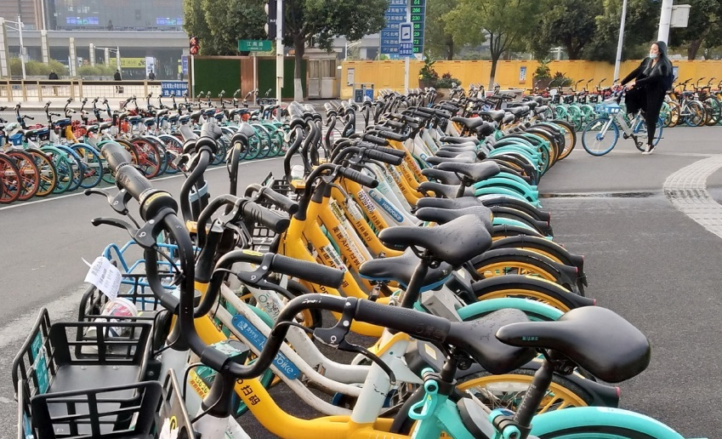
Culture Focus-The Four Great Inventions: new version
Sharing bikes: New way of travelling
Sharing bikes were the third on the list of the new “Four Great Inventions”. This new way of low-carbon transportation has attracted great public interest.
The bikes can be used by scanning the QR code with a mobile phone and be parked near on the sidewalk close to one’s destination.
The bike-sharing industry is supported by cutting-edge technologies such as GPS systems, mobile payments and big data, and it has greatly boosted the sharing economy in China since its debut.

Slide 96
Culture Focus-The Four Great Inventions: new version
Online shopping: New retailing
Online shopping, which was hailed as the fourth great invention of this age, has recently been ousted by the emerging concept of “new retailing”.
Jack Ma, founder of China’s largest online shopping platform Taobao.com, introduced the concept of new retailing to the Chinese market in 2016, and Alibaba Group soon became a forerunner in new retailing.
By combining the online services and offline stores, Ma and his Alibaba Group have been gradually exploring the boundaries available with new retailing.

Slide 97
Culture Focus-The Four Great Inventions: new version
In August, 2017, Alibaba’s market value exceeded 400 billion US dollars, making it the first Asian listed company to reach that level and become one of the world’s retail giants. The company’s CFO Maggie Wu said that new retailing has contributed greatly to its 56 percent year-on-year turnover growth.
And the evolution has just begun, not only for new retailing - or the new “Four Great Inventions”, but for the new lifestyle and ideas they brought to the Chinese people and to the world.

Slide 98
Home Reading—Sentence Translation
Sentence Translation
Translate the following sentences from Text B into Chinese.
While many in the West fret about AI eliminating jobs and worsening wealth and income inequality, China seems to believe it can bring about precisely the opposite outcomes. (Para. 4)
虽然西方许多国家担心人工智能会消除就业机会，加剧财富和收入不
平等，但中国似乎相信，人工智能能带来恰恰相反的结果。

Slide 99
Home Reading—Sentence Translation
2) The talk touches on the interwoven trends that have driven the recent rise
in machine intelligence: more powerful computers, ingenious new
algorithms, and huge quantities of data. (Para. 11)
这场演讲触及了推动最近机器智能兴起的相互交织的趋势：更强大
的计算机、巧妙的新算法和大量的数据。

Slide 100
Home Reading—Sentence Translation
3) Across just about every industry, Chinese companies are
shrugging off their reputation for following Western businesses,
and investing heavily in research and development. (Para. 23)
几乎在每一个行业，中国企业都在摆脱跟在西方企业后面跑
的名声，在研发上投入巨资。

Slide 101
Home Reading—Sentence Translation
4) Baidu anticipated the potential of artificial intelligence and sought
to leverage it to reinvent its whole business. (Para. 24)
百度预见到了人工智能的潜力，并试图利用它重塑整个业务。

